Slide 1

Ecommerce Website Project Presentation

Slide 2
Software and Implementation
SQL Server – Database
Visual Studio Code – Angular
Visual Studio – Dot Net
HTML
CSS

Slide 3
Data Flow Diagram
Diagram
Backend
Ecommerce Database
Frontend
Ecommerce Website
Product Table
Asp .net core EcommerceWebApi
Ecommerce Application
Table Login
Product Category
Model View Controller Classes
User
Admin

Slide 4
Ecommerce Website Features
User can see the website login and able to register to the site.
Add the items to the cart and buy.
Any time user can able to purchase.

Slide 5
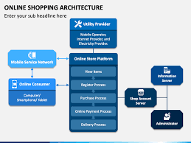
Ecommerce Architecture

